Slide 1


Slide 2
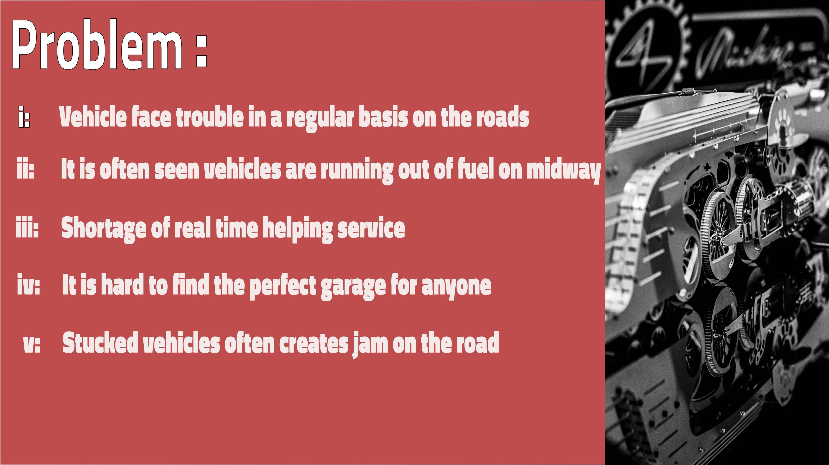

Slide 3
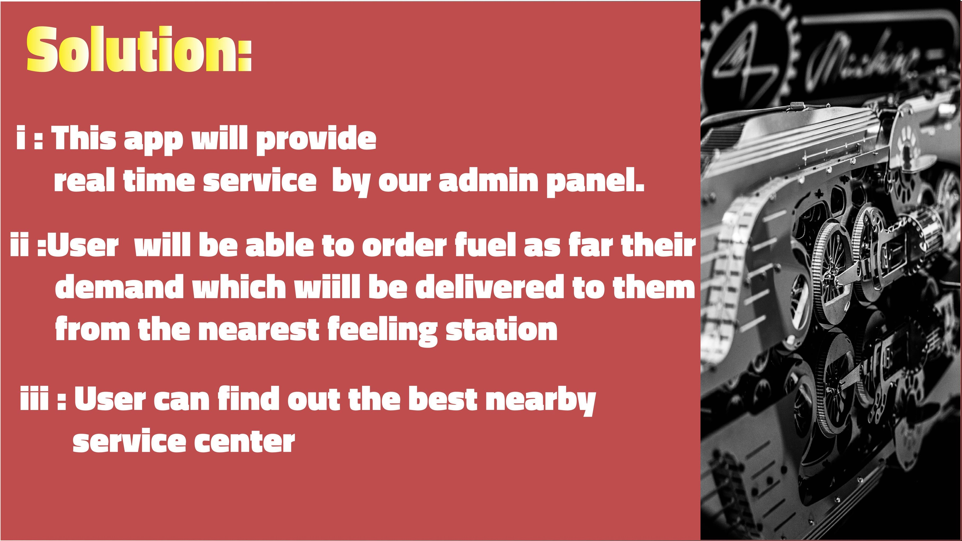

Slide 4

OBJECTIVE
We will use php and javascript to develop our project both for android and ios system. A huge number of people may have problems with running out of fuel on the road. Our application will have fuel delivery service. Users will be able to order fuel as per their demand which will be delivered to them from the nearest filling station. The app will provide the distance between the trouble facing vehicle and the garage . the vehicle owner can connect to the nearby garage through our app. We will use a map where we will put the nearby garage locations . we will keep review system in our app . Many packages will be given in our app by calculating the distance and work of our technician services.

Slide 5
Output
If you use our app It will be time consuming surely.
By using our app you can judge which one is the best nearby garage provides the best service.
(iii) After surveying real data we found that there are lots private vehicle owner who don't have real knowledge of the repairing cost . If anyone use our app they will get a good knowledge of the repairing cost from our repairing packages
(iv) Users will be able to order fuel as per their demand which will be delivered to them from the nearest filling station.

